Slide 1
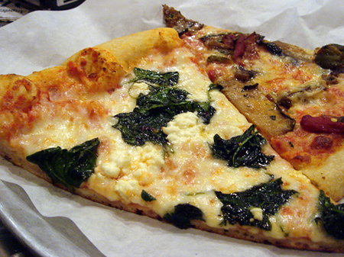
Topic: Rational Numbers EQ: How do I divide rational numbers?

Slide 2

LESSON OBJECTIVES
I will divide fractions by finding the inverse.

Slide 3
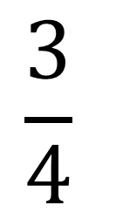
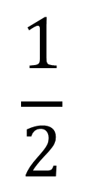
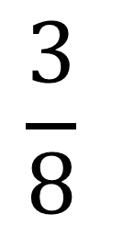
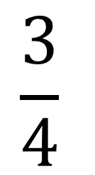
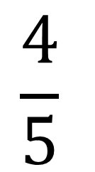
Daily Review
$$\frac{1}{2}$$
$$\frac{3}{4}$$
$$\frac{4}{5}$$
$$\frac{3}{4}$$
$$\frac{3}{8}$$
+
-
+
2

Slide 4






Daily Review
When you see word of, you replace it with…
a multiplication sign.
What is 5 lots of 2?
5 x 2 = 10

Slide 5
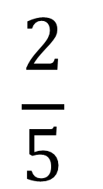
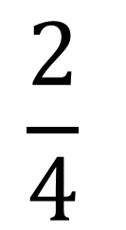
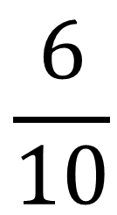
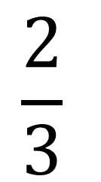
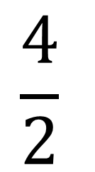
Daily Review
(Multiplying Fractions)
$$\frac{2}{5}$$
$$\frac{4}{2}$$
$$\frac{2}{3}$$
$$\frac{6}{10}$$
$$\frac{2}{4}$$
x
3
1
3
OF
OF
Multiply the top
Multiply the bottom

Slide 6
Finding the Inverse
An inverse is the opposite of something.
To invert something is to put it upside down or in the opposite position.
The inverse of UP is…
DOWN!

Slide 7
Finding the Inverse
An inverse is the opposite of something.
To invert something is to put it upside down or in the opposite position.
The inverse of LEFT is…
RIGHT

Slide 8



Finding the Inverse
The inverse of ADDITION is…
SUBTRACTION
The inverse of DIVISION is…
MULTIPLICATION

Slide 9



Finding the Inverse
The inverse of this fraction is…
$$\frac{5}{8}$$
$$\frac{8}{5}$$
SWITCH IT!

Slide 10
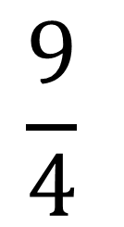
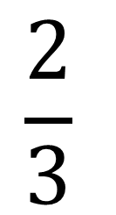
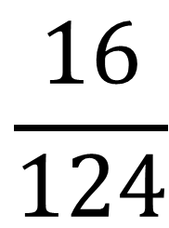
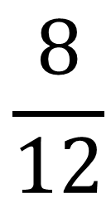
Finding the Inverse
Find the inverse of these fractions.
$$\frac{2}{3}$$
$$\frac{9}{4}$$
$$\frac{8}{12}$$
$$\frac{16}{124}$$

Slide 11
LEAVE IT
SWAP IT
SWITCH IT

Slide 12
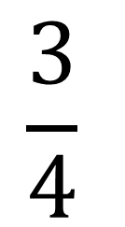
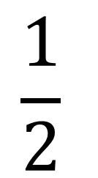
Dividing Fractions
$$\frac{1}{2}$$
$$\frac{3}{4}$$
÷
One divided by two, divided by three divided by four…
WHAT?
How do we solve it?

Slide 13
LEAVE IT
Invert it
SWAP IT
SWITCH IT

Slide 14
https://wes.nwcomplex.org/apps/video/watch.jsp?v=120450

Slide 15

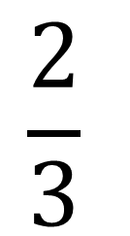
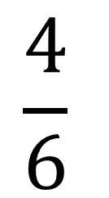
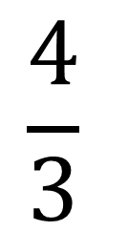
Dividing Fractions
$$\frac{1}{2}$$
$$\frac{3}{4}$$
÷
1.
Leave it
2.
Swap it
$$\frac{4}{3}$$
=
x
3.
Switch it
$$\frac{4}{6}$$
$$\frac{2}{3}$$
=
=

Slide 16
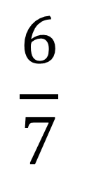
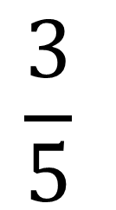
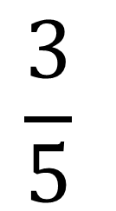
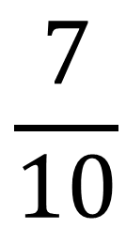
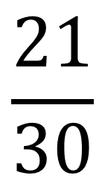
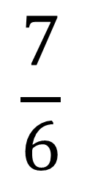
Dividing Fractions
$$\frac{3}{5}$$
$$\frac{6}{7}$$
÷
1.
Leave it
2.
Swap it
$$\frac{3}{5}$$
$$\frac{7}{6}$$
=
x
3.
Switch it
$$\frac{21}{30}$$
$$\frac{7}{10}$$
=
=

Slide 17
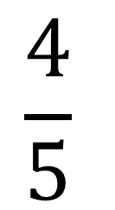
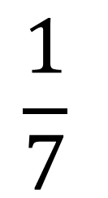
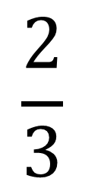
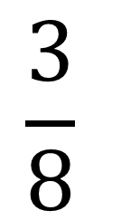
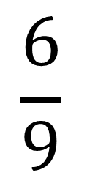
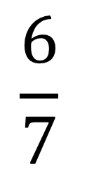
Dividing Fractions
$$\frac{4}{5}$$
$$\frac{2}{3}$$
$$\frac{6}{9}$$
$$\frac{6}{7}$$
$$\frac{1}{7}$$
$$\frac{3}{8}$$
÷
÷
÷
Leave it
Swap it
Switch it

Slide 18
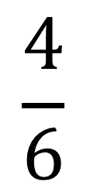
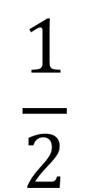
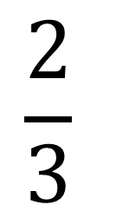
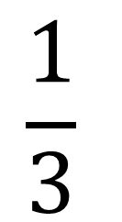
Dividing Fractions
$$\frac{1}{2}$$
$$\frac{2}{3}$$
$$\frac{4}{6}$$
$$\frac{2}{3}$$
$$\frac{1}{3}$$
2
÷
3
÷
4
11
÷
6
Leave it
Swap it
Switch it

Slide 19
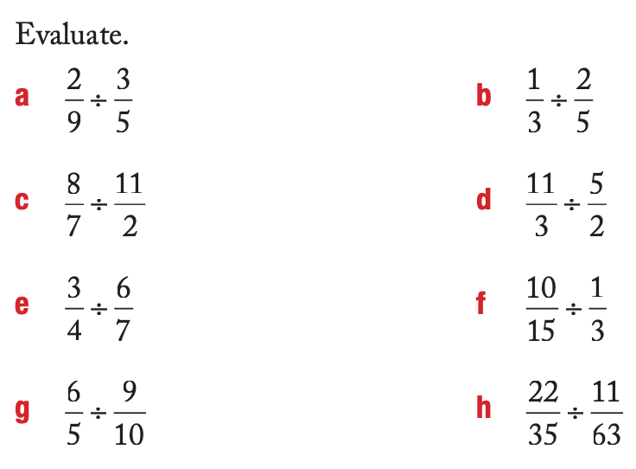
Independent Practice

Slide 20
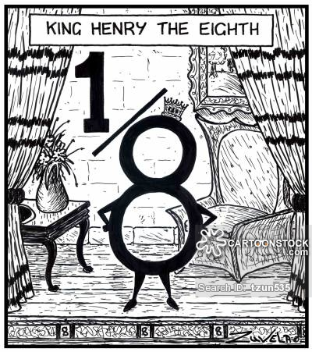
What have we learnt today?
Lesson Objectives:
I will divide fractions by finding the inverse.
What is the phrase to remember how to divide fractions?
Leave it, Swap it, Switch it

